Slide 1
STEPs TO an autopsy
By: kinizie martin

Slide 2
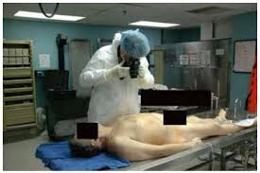
Step 1 external examination
Measured and Weighted
Eye fluid is extracted

Slide 3
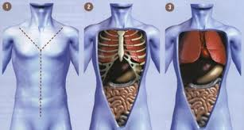
Step 2 internal examination
You cut a Y incision to expose the internal organ front of each shoulder to bottom of each breast bone. The Y’s tail extends from the sternum to the pubic bone.
This incision is very deep going to the rib cage on the chest and completely through the abdominal wall.
The skin is then pilled back with the top flap pulled over the face.

Slide 4
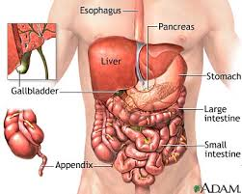
Step 3 viewing the organs
Ribs are sawn to expose the internal organs.
The sternal plate or anterior chest wall is all away, to expose the organs underneath.

Slide 5
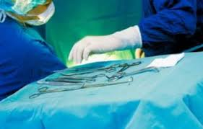
Step 4 removal of organs
The Rokitansky Method is the most common way in removing the bodies organs.
The method is to just take all organs out at once.
Including the heart, lungs, liver, kidneys and spleen etc., and the dissected on the autopsy table.

Slide 6
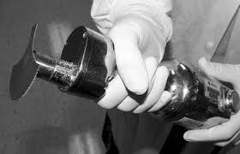
Step 5 removing the brain
An incision is made in the back of the scalp from one ear to the other.
Then the scalp is cut and separated from the under lying skull and pulled forward.
The skull is then removed using a vibrating saw.
Then the brain is removed and either cut or placed in a 20% solution.

Slide 7
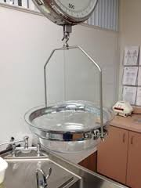
Step 6 weighing the organs
All organs get weighted and dissected all except Intestines and stomach are not weighed. The intestines are drained in a sink of any undigested food and feces. Then the stomach is cut open and the contents are examined.

Slide 8
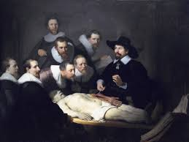
Step 7 returning organs to the body
The organs can then be replaced back in the body or the body can be filled with a filler material and then the body is sewn up

Slide 9
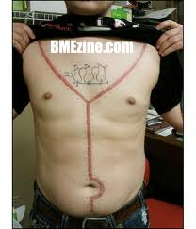
Step 8 sewing up the body
The forensic technician will sew the body back up after the pathologist is completely done.
Once the incision and head is sewn up the autopsy if completed.

