Slide 1
DNA ANALYSIS LAB TECHNIQUES
By Kinzie Martin

Slide 2
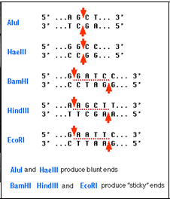
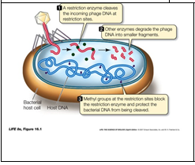
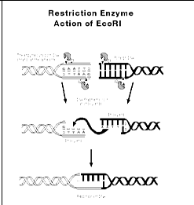
What are restriction enzymes and how do they cut DNA?
Restriction enzymes come from bacteria and are cut DNA in different places.

Slide 3
What is PCR and how does it amplify DNA?
What is PCR?
PCR (short for Polymerase Chain Reaction
What polymerase means>/ break it down by looking up the roots poly, mer, and ase?
Poly- means many or much
Mer -means part
Ase- ending on enzyme names

Slide 4
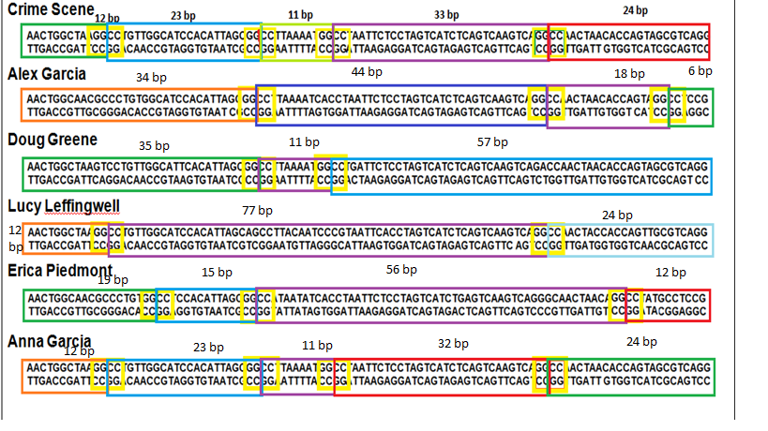
PCR crime scene RFLPs

Slide 5
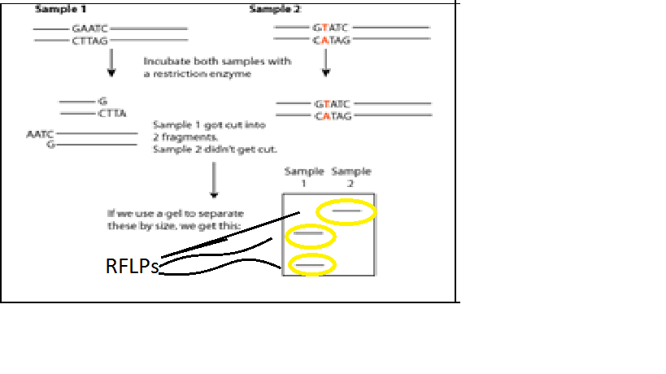
What are RFLPs and how are they used to compare DNA?
RFLPs
Restriction Fragments Length
Poly morph ism (many difference conditions)
the length from each person are different and that’s what tells a DNA fingerprint apart
the DNA is cut by restriction enzymes and the fragments are RFLPs.
The tell us the difference between two people

Slide 6
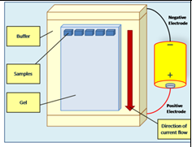
What is gel electrophoresis and how is used/interpreted?
GEL ELECTROPHORESIS
Gel electrophoresis make RFLPs visible by separating them
It separating by the size.
You can separate the DNA fragments by applying an electric current to the gel.
DNA will migrate to the positive side.

Slide 7
Gel Electrophoresis
Gel electrophoresis separates RFLPs by electric current
Electrophoresis (Electro- electricity phore-carry sis-condition)
the condition of carrying DNA using electricity.
By a pulling of a positive charge
The phosphate in DNA give it an negative so it can be pulled to the positive end.
The smallest pieces move the farthest because they are easier to pull.

