Slide 1
Players in the protein game
By: Kinzie martin

Slide 2
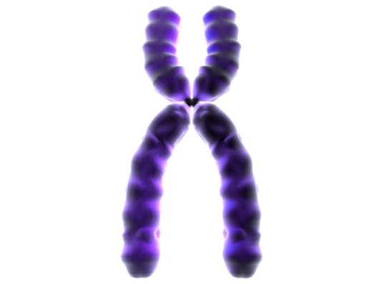
Chromosomes
chromosomes are large enough to be seen under a microscope.
In one single chromosome you can find DNA’s double helix.

Slide 3
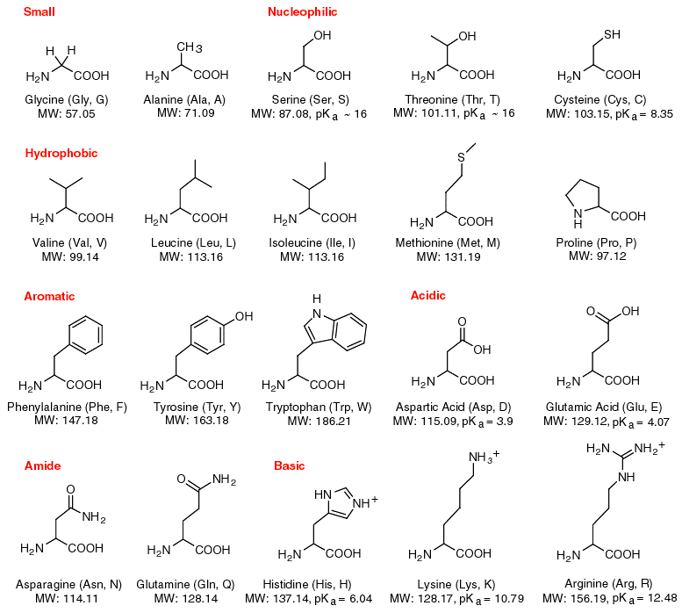
Amino acids
Amino acids work with ribosomes to build a protein.
Amino acids grow till told to stop
The amino acids are located in the cytoplasm.

Slide 4
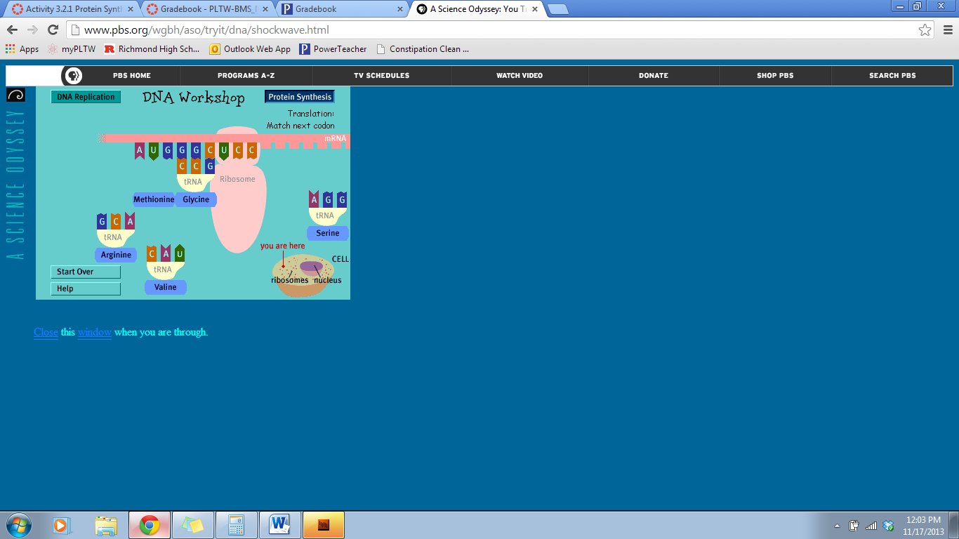
trna
Delivers the amino acids to the ribosome to combine to make a protein chain.
Recognizes a specific amino acid that are then linked together within the ribosome
At one end of the tRNA is an amino acid and the other end is 3 nitrogenous bases.
tRNA is found in the cytoplasm

Slide 5
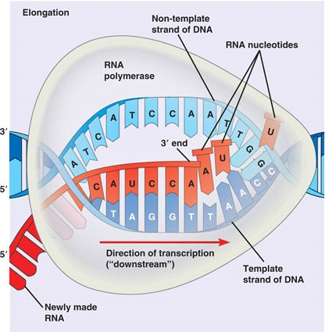
Rna polymerase
The job of RNA polymerase is To unzip the DNA and copies it onto the one stranded of mRNA and is present in the nucleus.
COMES FROM YOUR MOM!!!!!
RNA polymerase is an enzyme
RNA Polymerase connect nucleotides as they pair with the DNA strands nucleotides.

Slide 6
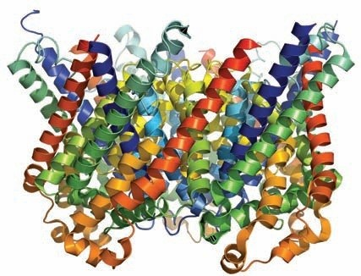
DNA
DNA carries the instructions to produce proteins (like a recipe book)
Genetic code for a person

Slide 7
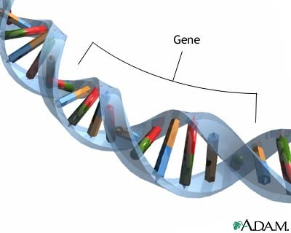
Gene
1 gene codes for 1 protein

Slide 8
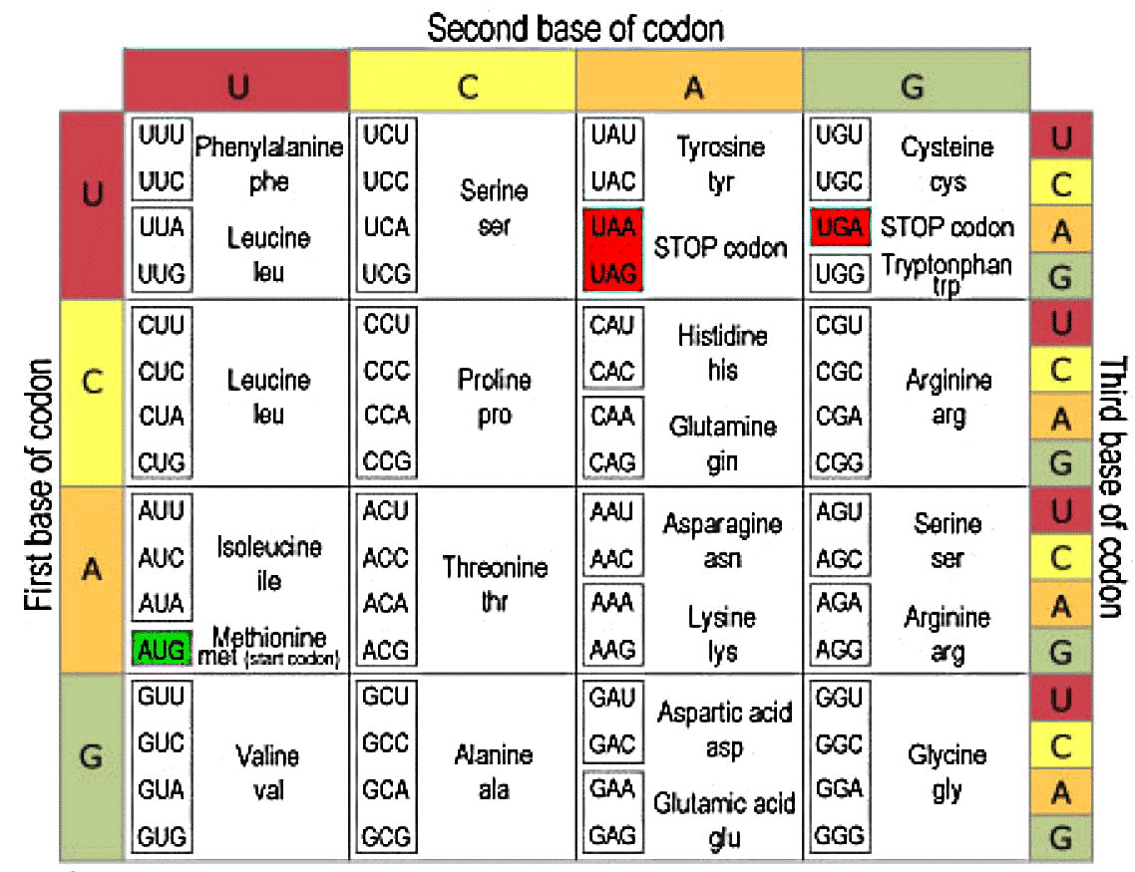
Codons
3 nucleotides are one codon
tRNA has an anticodon at the end the amino acid

Slide 9
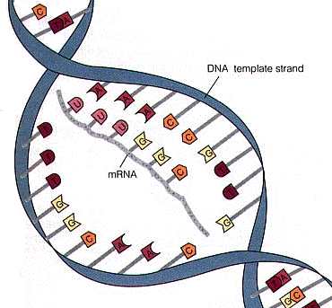
mRNA
mRNA is small enough to travel out of the cell.
mRNA is a copy of the gene that is being encoded in the DNA.
small enough it can fit through the nucleus

Slide 10
proteins
the human body may contain over two million different proteins
Proteins are made inside the cell by the DNA code.

Slide 11
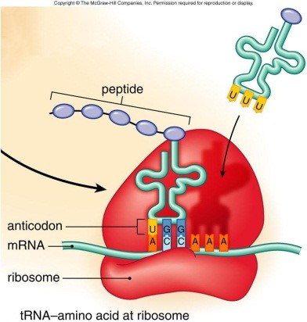
Ribosomes
Reads mRNA
Link together amino acids
Reads the order of a nucleotide
Builds the amino acids at the start of the nucleotide AUG

