Slide 1
MANNERS OF DEATH
By: KINZIE MARTIN

Slide 2
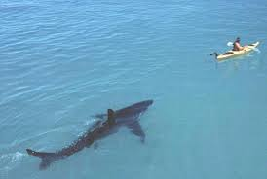
ACCIDENTAL 40%
Accidental death are the most common types of death. There are a major group of things that can be considered an “Accidental” death. AN accidental death must be avoidable and unintentional.

Slide 3
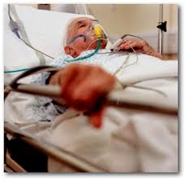
NATURAL 38%
The second most common way for humans to die is by a natural cause of death. This kind of death would consist of something like lung cancer, old age, stroke, heart attack, and even drowing in some cases is considered a natural way of death.

Slide 4
SUICIDE 9%
As the rate of suicide in teens go up the numbers are not as high as we think. Suicide and homicide are tied for the 3rd highest death manners. Suicide is something very serious. Things such as hangings, shooting yourself, purposeful overdose, or even jumping off a bridge.

Slide 5
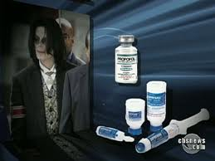
HOMICIDE 9%
Tied for 3rd homicide is an inclining death manner. Homicide victims normally show signs externally or internally. Homicide can be either involuntary or man slaughter. Things such as poisons, and purposefully slipped drugged and a shot to the head or chest and a car wreck can be considered homicide. In Michael Jacksons case the courts tried to convict his doctor for giving Jackson to much medication.

Slide 6
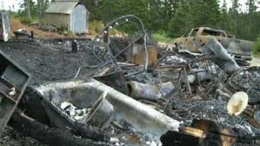
UNDETERMINED 4%
Last but not least undetermined deaths are not common but possible. The reason undetermined is so rare is because it is very hard not to be able to find a reason with todays technology. The rare cases that undetermined would be used is if parts of remains were found and the decay process has taken place and animals have been chewing on the bones making impossible to find a cause of death.

