Slide 1
Human Body Systems
By: Kinize Martin

Slide 2
Skeletal system
FUNCTION (S): Protects and supports body organs; provides a framework the muscles can use to cause movement; stores minerals.
KEY STRUCTURES:
• Bones
• Joints
!SUPPORT!
*bone marrow- makes blood cells (white & red)

Slide 3
Nervous system
FUNCTION (S): Responds to internal and external changes by activating an appropriate response; processes information.
KEY STRUCTURES:
Brain
Spinal cord
Sensory receptors
Nerves
NERV- nerve, tendon
OUS- full of
*nervous- full of nerves
!RESPOND / COMMUNICATE!

Slide 4
Respiratory system
FUNCTION (S): Assists with gas exchange with the external environment; keeps blood supplied with oxygen and removes carbon dioxide.
KEY STRUCTURES:
• Lungs
• Nasal cavity
• Trachea
• Bronchus
!EXCHANGES!

Slide 5
Integumentary system
FUNCTION (S): Forms the body’s external covering; protects deeper tissue from injury; helps regulate body temperature.
KEY STRUCTURES:
• Skin
• Hair
• Nails
Skin- also is in the immune system.
! REGULATES & PROTECTS EXTERNAL !

Slide 6
Digestive system
FUNCTION (S): Breaks down food into its nutrient molecules; absorbs nutrients; rids the body of waste.
KEY STRUCTURES:
• Oral cavity
• Esophagus
• Stomach
• Small intestine
• Large intestine
Liver
! FUELS !

Slide 7
Urinary system
FUNCTION (S): Eliminates waste from the body; regulates water balance of the blood.
KEY STRUCTURES:
• Kidney
• Bladder
• Ureter
Urethra
URIN- urine
ARY- place for something
*Urinary- a place to store urine
! CLEANSES !

Slide 8
Muscular system
FUNCTION (S): Moves the body and moves substances around the body; maintains posture; produces heat.
KEY STRUCTURES:
• Skeletal muscle
• Cardiac muscle
• Smooth muscle
! MOVES !

Slide 9
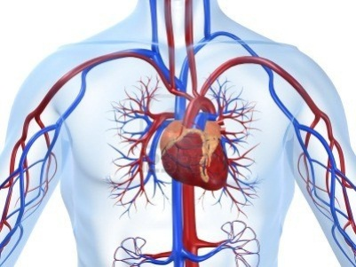
Cardiovascular system
FUNCTION (S): Pumps blood around body; transports oxygen, carbon dioxide, nutrients, and waste.
KEY STRUCTURES:
Heart
Blood vessels (veins, arteries, and capillaries)
CARDIO- heart
VAS- vessel
CULAR- small
*Cardiovascular- heart and small vessels
! TRANSPORTS !

Slide 10
Endocrine system
FUNCTION (S): Secretes hormones that regulate processes such as growth, reproduction, and metabolism by body cells.
KEY STRUCTURES:
• Adrenal gland
• Pituitary gland
• Ovary
• Testis
ENDO- within
CRINE- secrete
*Endocrine- to secrete within
! REGULATES & CONTAINS
HORMONES !

Slide 11
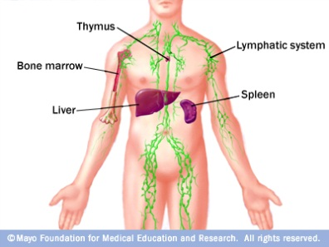
Lymphatic and Immune
FUNCTION (S): Filters fluid in the body; mounts the attack against foreign substances in the body.
KEY STRUCTURES:
Lymph nodes
Spleen
Thymus
Bone marrow
Appendix
tonsils
skin
LYMPH- means water
*Lymphatic- to filter lymph flood
(diseases and viruses)
Lymphatic system is part of the immune system.
Lymph nodes- water knots

