Slide 1
Endocrinologist
By: Kinzie Martin

Slide 2
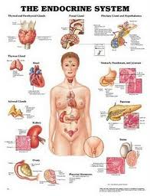
What do I do?
An endocrinologist is a specialist in diseases that affect your glands.
Such as:
hormones
thyroid
Diabetes
Menopause
Cancer of the endocrine glands
I see patience’s and diagnose and talk about treatments.
The daily testing I do consist of fine-needle thyroid biopsy's,
and blood glucose tests. I also help create special diet and
exercise plans to treat patients suffering from lipid disorders,
or use hormone replacement therapies for women dealing
with menopause. I also do research trying to find various treatments.
I share my information with pharmacy companies,
public research institutes, and colleges and universities.

Slide 3
What does it take?
It takes 4 years of medical school.
Then it most people go to an interning program for 3-4 years after that Then they take the extra step and to 2-3 years of learning how to diagnose and treat their specialized conditions.
In most cases it takes of 10 years of schooling to fully complete school.
To become an endocrinologist first you would need to get a Medical Degree (M.D.) Most medical schools you would need to undergrad in biological sciences, chemistry, mathematics and physics.
I attended the school of Ashford University. I took the measures above to become a endocrinologist.
I mostly work with patience’s and with other endocrinologist in research.

Slide 4
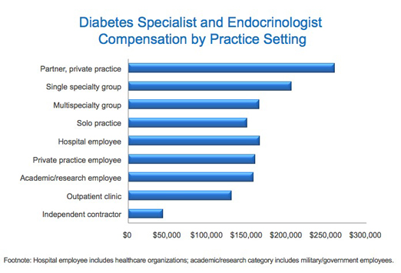
What is the reward?
An endocrinologist’s salary is around $175,000a year. National salary is about $212,281 per year. The salary for an endocrinologist depends on several things such as type of specialization, work experience, locality and workplace. An average income for the endocrinologist can be higher if the workplace has more numbers of employees.
I make around 210,000 dollars a year. Because I only work with mainly thyroid diseases I don’t get top pay.

