Slide 1
Changing one nucleotide
3.2.3.
By: Kinzie Martin

Slide 2
Tasch vs. sickle cell
Similarities
Both mutations
Both substitution mutations
Both are recessive
Both have a certain type of ethnicity
They both effect a protein

Slide 3
Tay sachs vs. sickle cell
Tay sack difference
Any one who is Ashkenazi Jew ; French Canadian
Is a decency in a protein
Is an enzyme that breaks down brain fats
No cure or treatment
Part of the nervous system

Slide 4
Tay sachs vs. sickle cells
Sickle cells
Comes from anyone near the equator or tropical areas.
Is a deficiencies in the protein
Is a transport protein and the protein is hemoglobin.
Part of the circulatory system
Has a cure and a treatment

Slide 5
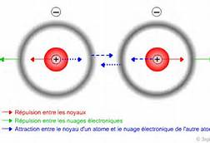
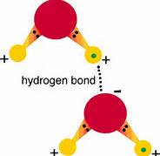
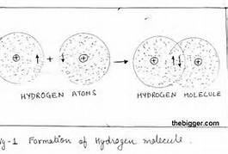
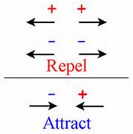
Four forces at work (amino acids)

Slide 6
Van der waals forces
All atoms are sticky
Van der waals attract each other like humans

Slide 7
Electrostatic Charge
2 positive repel
1 positive and 1 negative they attract

Slide 8
S-s bonds
2 cysteine forms a sulfur bridge and pull everything else with it and the 2 stick together with extreme force.

Slide 9
Hydrogen bonds
Only happens when they are in water
Affects the atoms in the body because the body is mostly water.
A hydrogen bond is when opposites attract to water.
with any charge can be attracted and even be polar.

Slide 10
Hydrophilic
Literally means water lover.
POLAR (has charges)
Amino acids : + arginine, lysine + ; - aspartic acid , glutamic acid; + threonine, asparagine, histidine, serine, glutamine -

Slide 11
Hydrophobic
Literally means fear or hate of water
Non- polar (neutral; no charge)
Amino Acid: Phenylalalnine, valine, isoleucine, leucine, tryptophan, glycine, alanine, proline

Slide 12
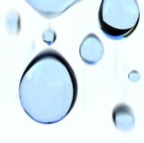
Effects of environment on protein
All hydrophobic
Alanine acid in water will come together and try and get away from the water
All hydrophilic
Glutamic acid in water will spread out and try and cover themselves.

Slide 13
Comparison
Sickle cells stick together because when you change the property to valine, valine is hydrophobic which is causing valine to stick to other hydrophobic parts of an amino acids.
Glutamic acid In NORMAL hemoglobin Hydrophilic (loves water) Polar/charged | Valine In sickled hemoglobin Hydrophobic (hates water) Non-polar/uncharged
Sickle cells stick together because when you change the property to valine, valine is hydrophobic which is causing valine to stick to other hydrophobic parts of an amino acids

