Slide 1
Biochemistry
Monomers, Polymers, ATP, and Macromolecules.

Slide 2
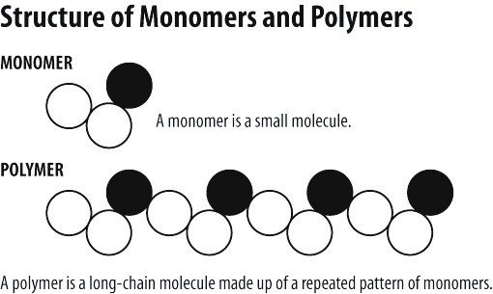
Monomers Vs. Polymers
Monomer- one part
Polymer- many parts
Monomers and polymers are like dehydration synthesis and hydrolysis because they both are adding and taking away water molecules. Monomers become polymers by binding water molecules. Polymers become monomers by taking away water molecules. Most foods we consume are polymers.

Slide 3
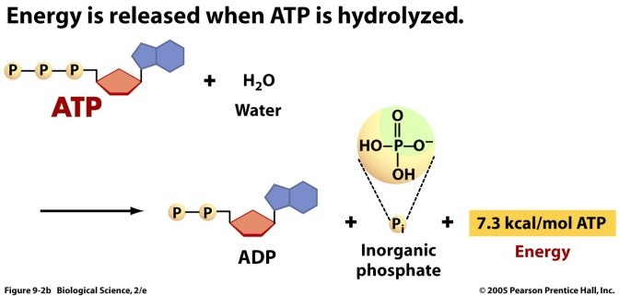
ATP & Macromolecules
Energy relates to food because we get our energy from our food intake. We release energy when bonds break from the hydrogen bonds. The energy is stored in the chemical bonds when the bonds are broken energy is released. When the polymers are broken it makes a monomer. This is a hydrolysis because it is breaking up water. Energy is stored in the ATP bonds.

Slide 4
Summary of the 4 Structure and Functions
Name of Macromolecule: | Composed of: | Building Block(s): | Function: | Examples: | Food Examples from Anna’s Diet
Carbohydrates | Carbon, hydrogen, and oxygen | monosaccharide | Primary source of energy | Bread, cereal, pasta | Fruits, sweetner
Proteins | Amine group carboxyl group and variable group | Amino acids | Build maintains repairs tissues in body | Fish, beef, meats and dairy | Salmon
Lipids | Hydrogen, carbon atoms with few oxygen atoms | Fatty acid | Stores energy, responsible for communication and bone structure and essential for structure of membrane | Fats, oils, vitamins such as A,E,D, and K | Peperoni pizza, ice cream
Nucleic Acids | Carbon, hydrogen, oxygen, nitrogen, phosphorus atoms | nucleotides | Stores and carries genetic information | DNA and RNA | X

Slide 5
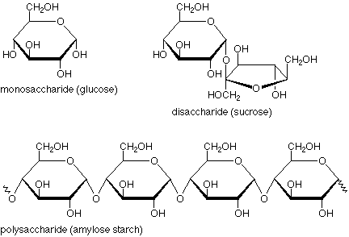
Carbohydrates
Starting from the top left the first one is a one sugar.
The next one on the top right corner that is a double sugar, and
the bottom molecule is a multiple.
Monosaccharide means one sugar.
Examples: Glucose , Fructose, Galactose
Cannot be broken down further in digestive tract.
Disaccharide means two sugars
Examples: Sucrose, Lactose
Breaks into monosaccharides
Polysaccharides means many sugars
Examples: Starch, Glycogen, and Fiber
Breaks into monosaccharides

Slide 6
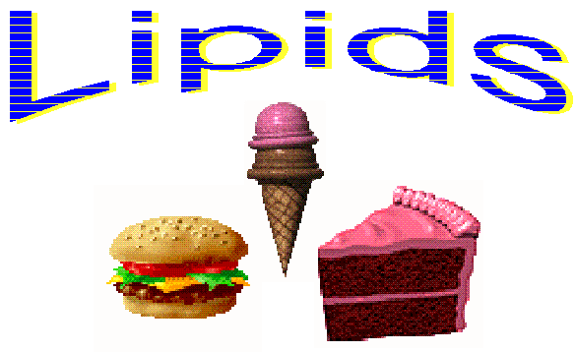
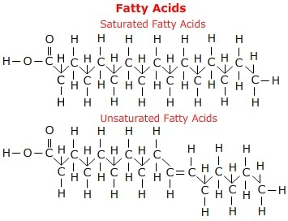
Lipids (fats)
Unsaturated have room for more hydrogen and have at least one double bond and is a liquid at room temp means HEALTHY
Mostly found in vegetables
Simple molecule
Saturated are fully covered with hydrogen. NO double bonds in carbon chain
IF solid at room temp means BAD!
Mostly from animals

Slide 7
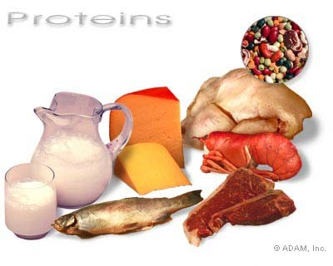
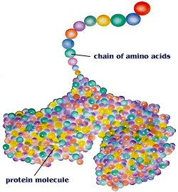
Proteins
Very complex molecules and are made of amino acids

Slide 8
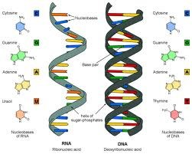
Nucleic Acids
The molecule of heredity☺☺
It is RNA and DNA

